Slide 1


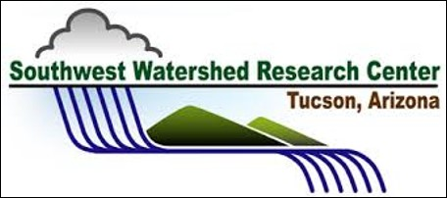
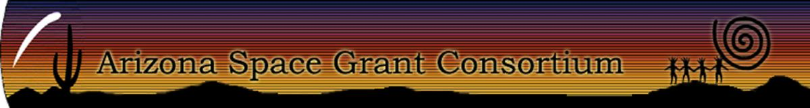
Soil hydraulic properties three years after the Frye Fire on Mount Graham, Arizona
By: Tyler Routt
Mentors: Dr. Jason Williams and Justin Johnson
2021 Arizona Space Grant Symposium

Slide 2
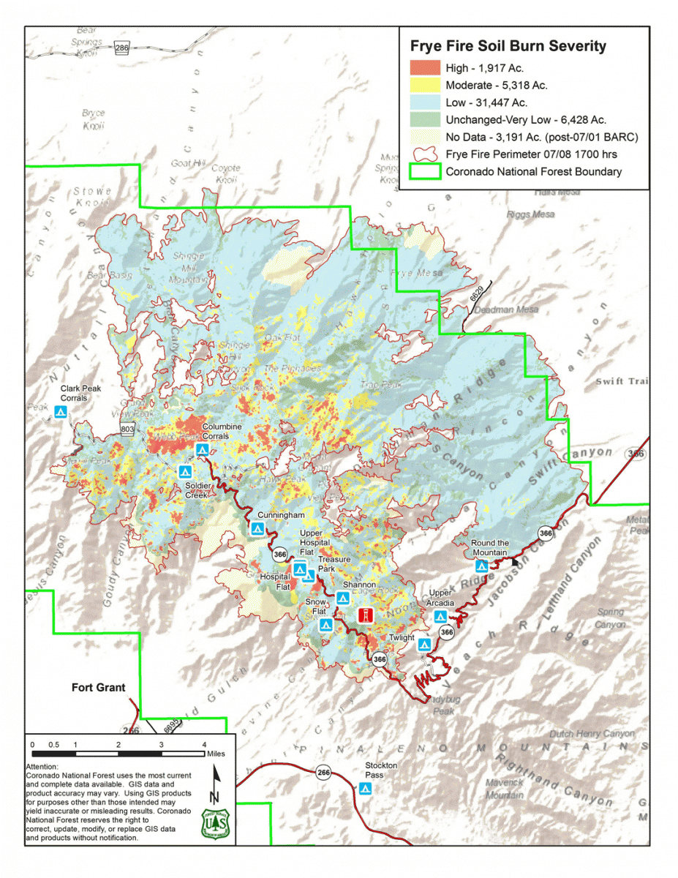
Background
2017 Frye Fire, Mount Graham, Coronado National Forest, Arizona
19,245 ha burned
Elevation ~2,745m
Mixed conifer forest
Source: Coronado National Forest Service

Slide 3
Problem, Question, Objectives
Fire increases the potential for runoff, erosion, and debris flow hazards. This poses risks to life, infrastructure, and ecological habitats.
What is the difference in soil hydraulic properties between mapped burn severities three years post fire?
Quantify soil water repellency, sorptivity, and hydraulic conductivity across burn severities

Slide 4
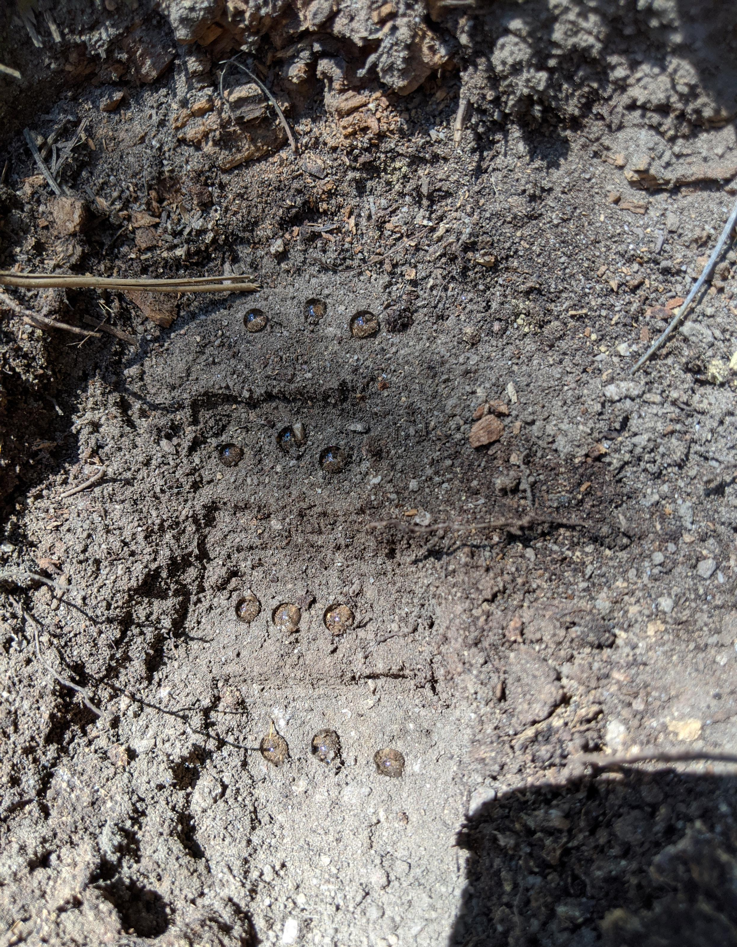
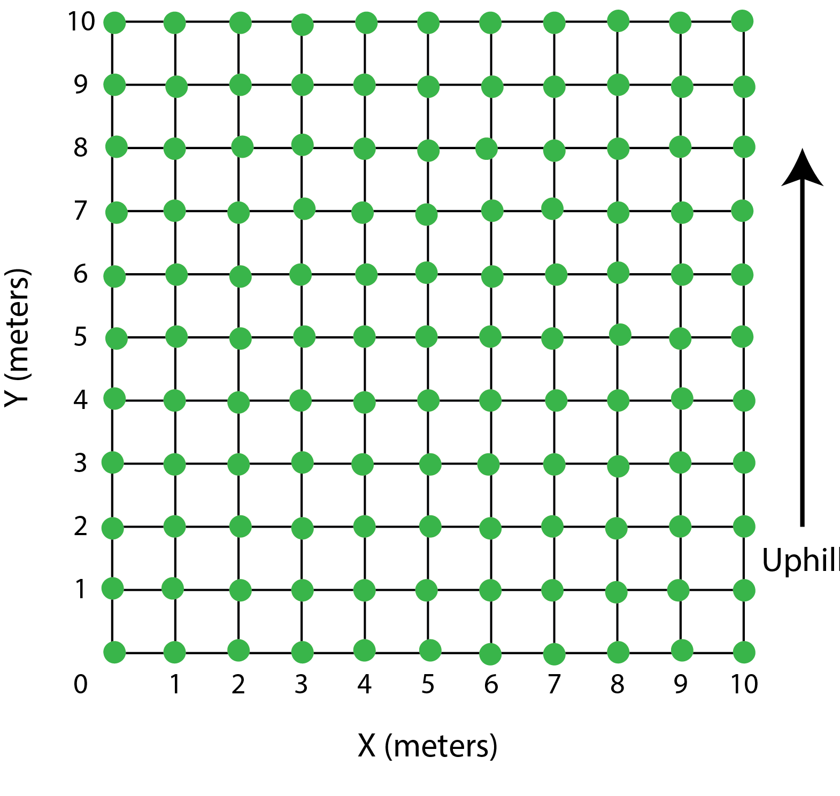
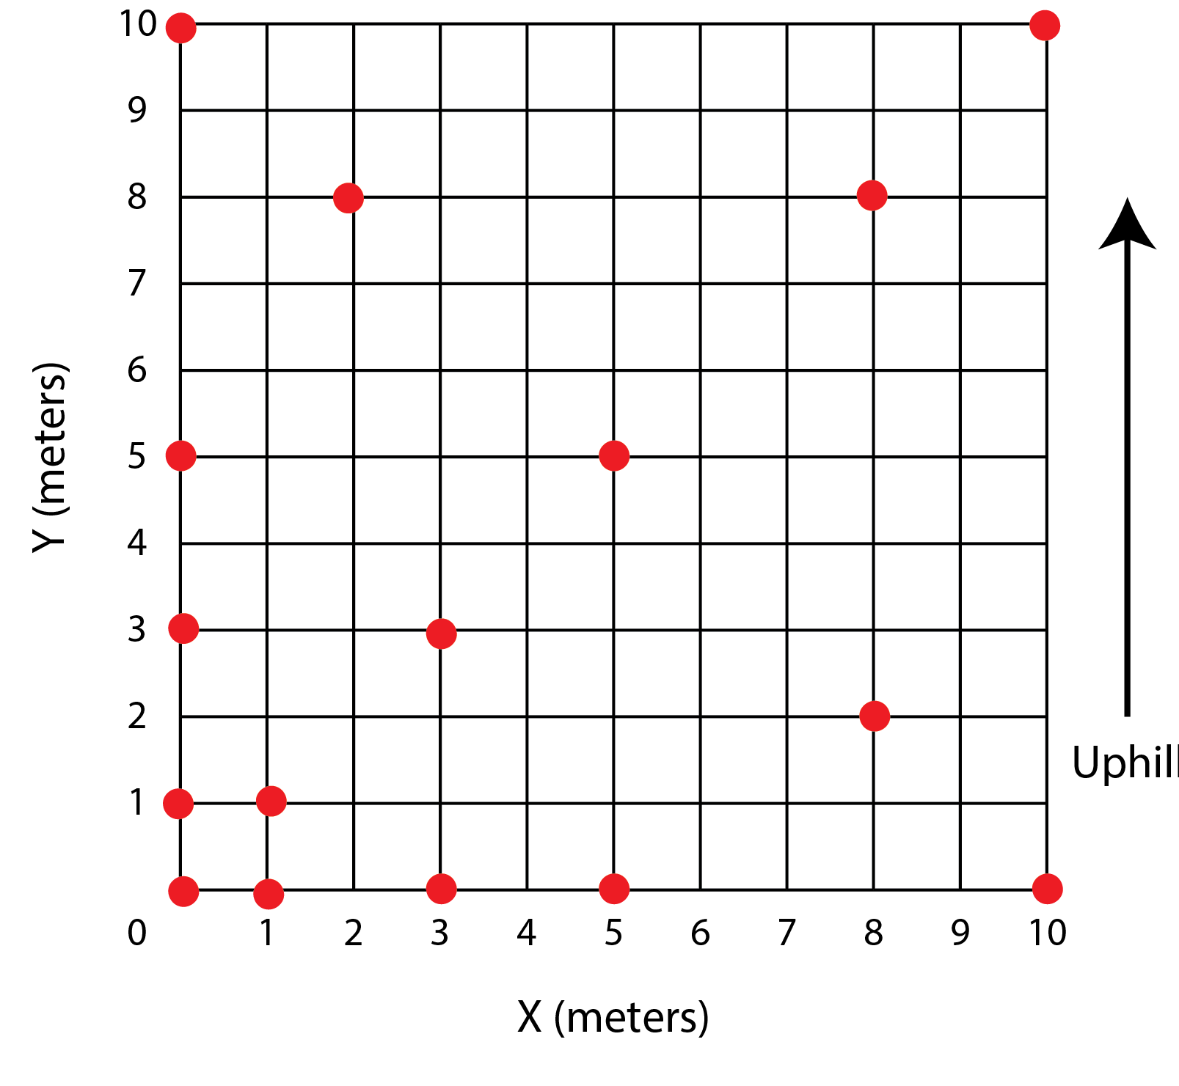
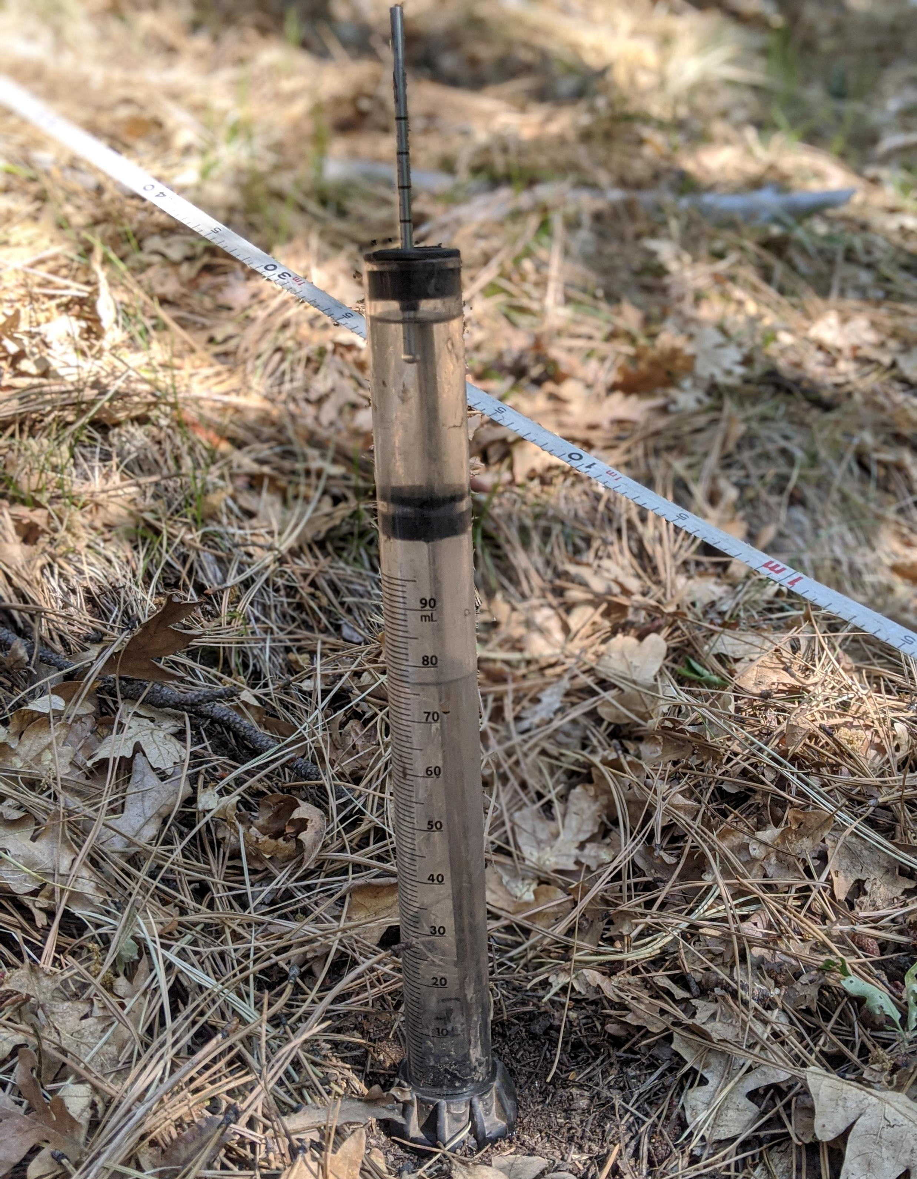


Experimental Design and Methods
Three 100 m² plots in each mapped burn severity (high, moderate, low, and unburned)
Measured soil water repellency using the water drop penetration time test (WDPT)
Measured sorptivity and hydraulic conductivity with a mini disk infiltrometer
Uphill
Uphill

Slide 5
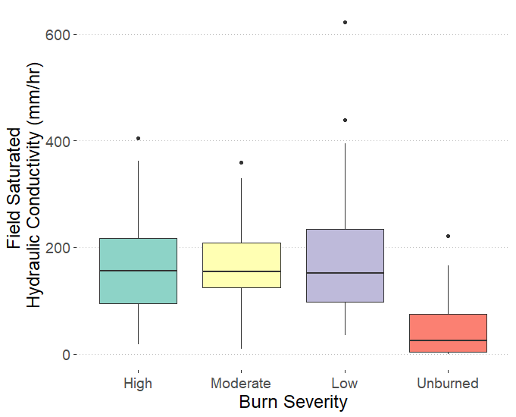
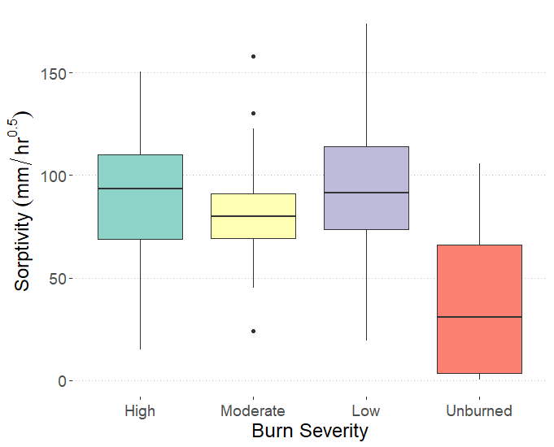
Results
Infiltration Experiments

Slide 6
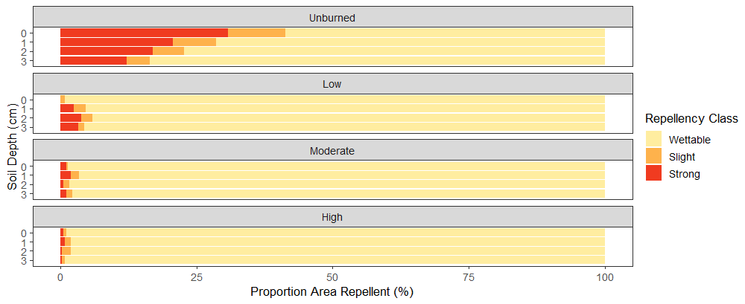
Results
Soil Water Repellency Experiment

Slide 7
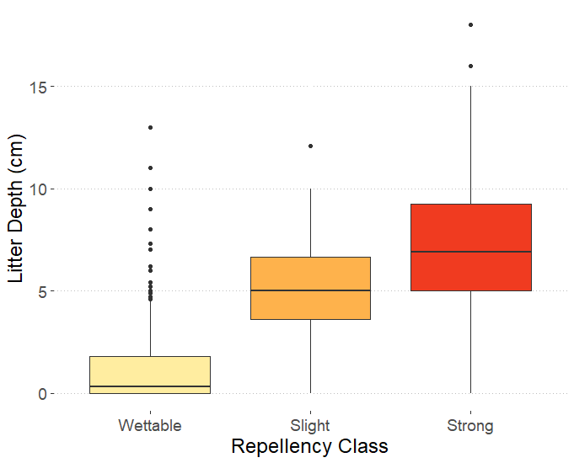
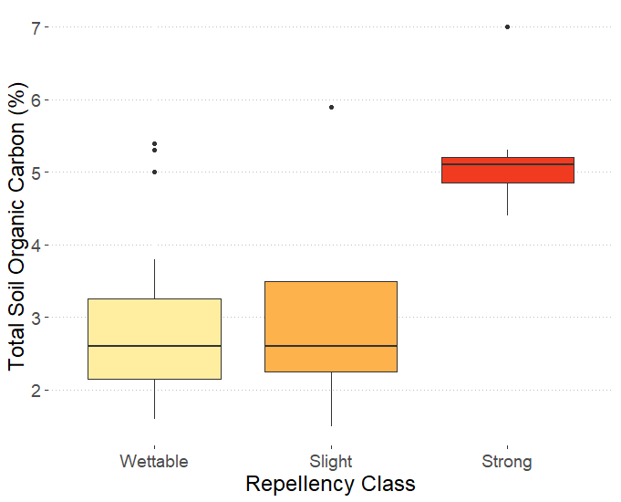
Results
WDPT Related to Environmental Factors

Slide 8


Conclusions
Burned plots showed higher infiltration rates and lower repellency than unburned
Soil hydraulic properties did not differ substantially between burned plots
Soil water repellency (WDPT) was positively related to litter depth and total soil organic carbon
Impact
Adds to the scientific knowledge on persistence of fire impacts on soil hydraulic properties
Contributes to improved risk assessment, targeting of post-fire mitigation practices, and reducing hydrologic and erosion related risks following wildfire
Future Research
Apply methods to recently burned sites and for various periods post-fire
Expand approach to include multiple sites and sampling over both seasonal and annual time scales

Slide 9
Acknowledgements
Mentors: Dr. Jason Williams and Justin Johnson
Dr. Luke McGuire- University of Arizona
Dr. Ann Youberg- Arizona Geological Survey
Coronado National Forest Service
Southwest Watershed Research Center (USDA-ARS)
Arizona Space Grant Consortium

Slide 10
Thank You

